Slide 1

HIVE Implementation & Process
REVIT University
TOOLS FOR EFFICIENT MODELS
Revit UNIVERSITY – September 13, 2023 PRESENTED BY Andres Fernandez, Christian Quintero

Slide 2
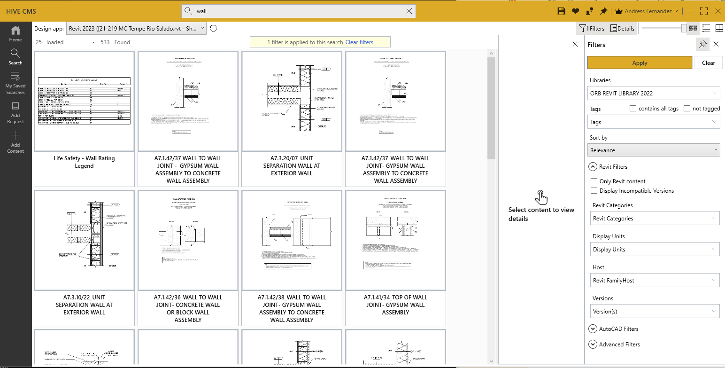
HIVE
HIVE is a content management software add-on used by ORB.
It is used to provide all users a single point of reference for all thing ORB.
HIVE is not limited to Revit model elements or families. ORB also provides additional information, manuals, forms and files from any platform that we use on a daily basis.

Slide 3
HIVE
The main focus of HIVE is to provide a single source of truth for all users.
Advantages:
No longer go hunting for content throughout the ORB server to find that one element.
Use content that has been approved and tested by BIM management
Use the same content from project to project, with the same graphic standards and same information embedded in them.

Slide 4
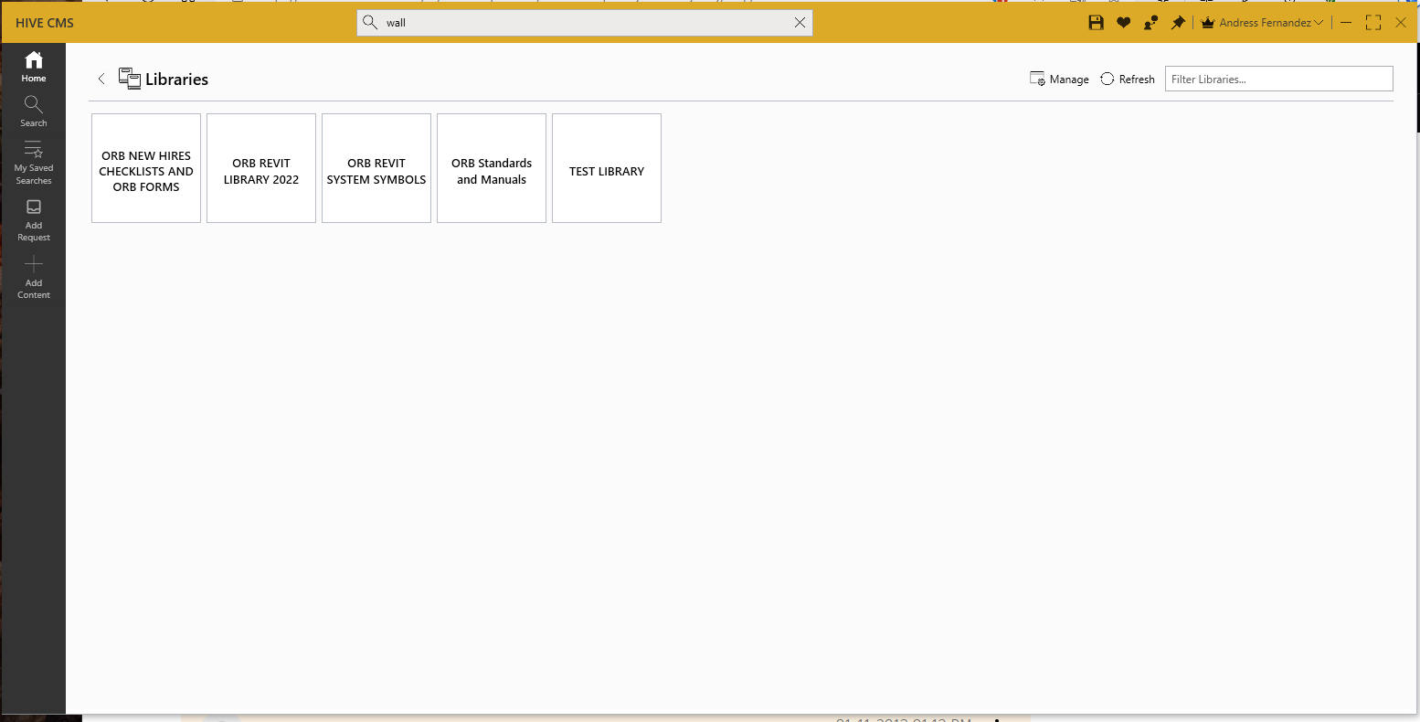
HIVE INTERFACE
HOME
Start in this window.
The user will have access to different libraries.
All elements that have been uploaded to HIVE have a library assigned to them.
Your search can be limited to the library you choose.
One element can have multiple libraries
By default, your search will include all libraries

Slide 5
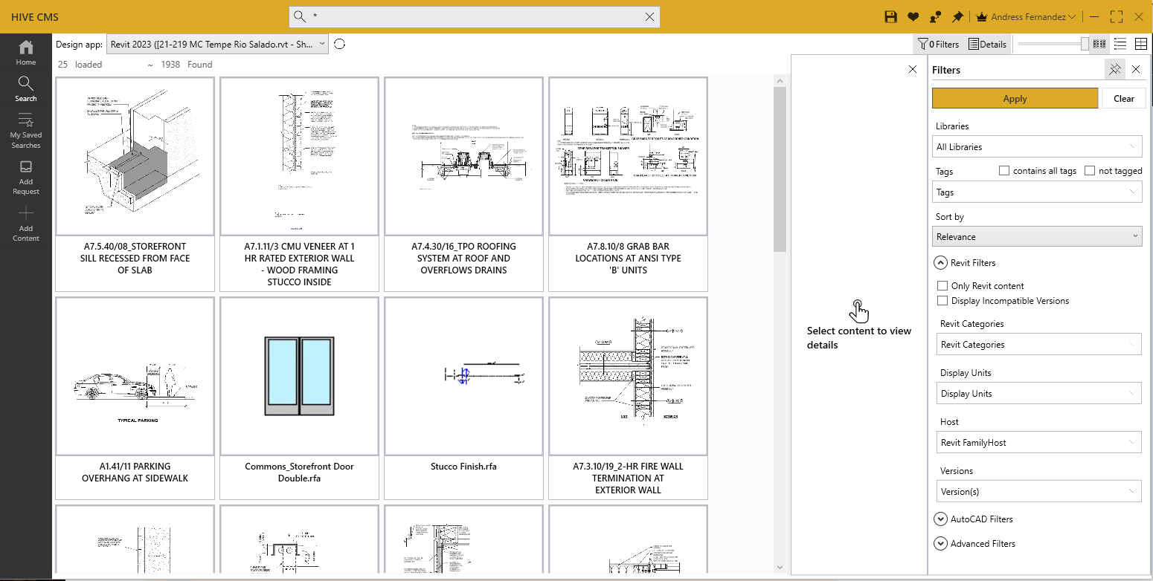
HIVE INTERFACE
SEARCH
The Search bar on top is always present.
The search icon will give you a starting point. This will provide you with a recent list of what you have searched and what has been recently uploaded

Slide 6
HIVE INTERFACE
FILTERS
A single word can provide you with a multitude of options in your search.
Type “wall” in your search and you will receive:
Revit Wall types
Sheets with wall assemblies
Detail views of our wall assemblies
Views that have “wall” in the title

Slide 7
HIVE INTERFACE
FILTERS
Avoid elements you are not looking for by using the filters in HIVE.
Limit your search to the intended library.
Search based on the TAG information
Search for Revit content only (no pdfs, no word files, etc)
Search by the Revit category you are looking for:
Walls,
Views,
Sheets
Doors,
Etc.

Slide 8
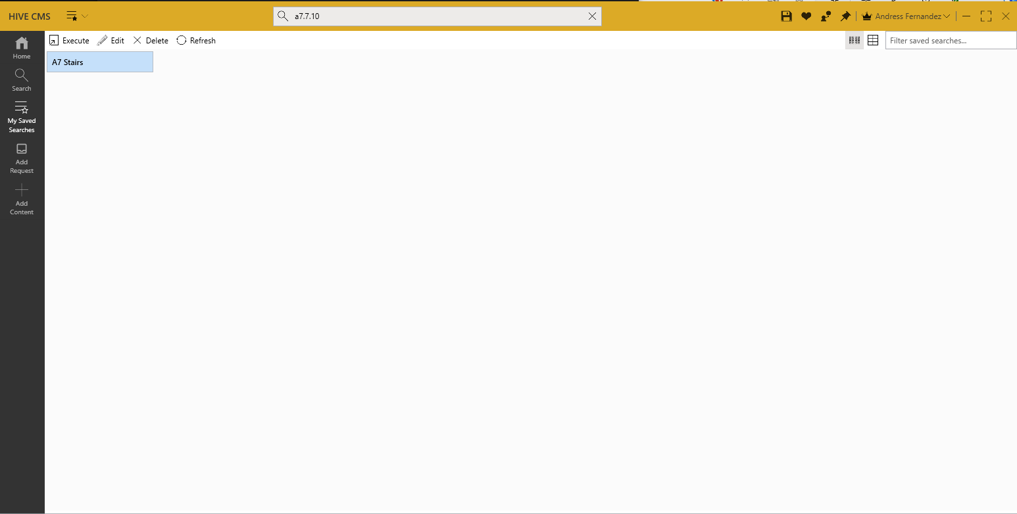
HIVE INTERFACE
SAVED SEARCHES
When you want to avoid repeating the same search over and over

Slide 9
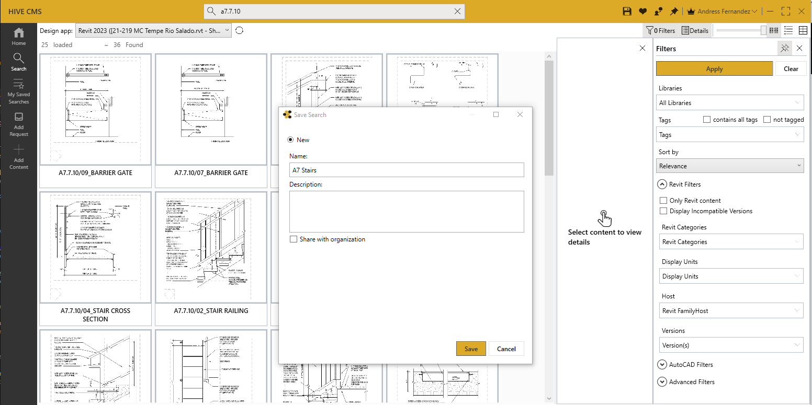
HIVE INTERFACE
SAVED SEARCHES
You can set up your search and give it a name.
The search parameters can be yours alone or shared with other users.

Slide 10
HIVE INTERFACE
SAVED SEARCHES
When you execute your search, the same results as before will come to you, but much faster.

Slide 11
HIVE INTERFACE
ADD REQUEST
When you are unable to find the content you need.
You can propose new families and/or Revit elements to be used by the office
You can request additional content
Wall assemblies
Details from previous projects

Slide 12
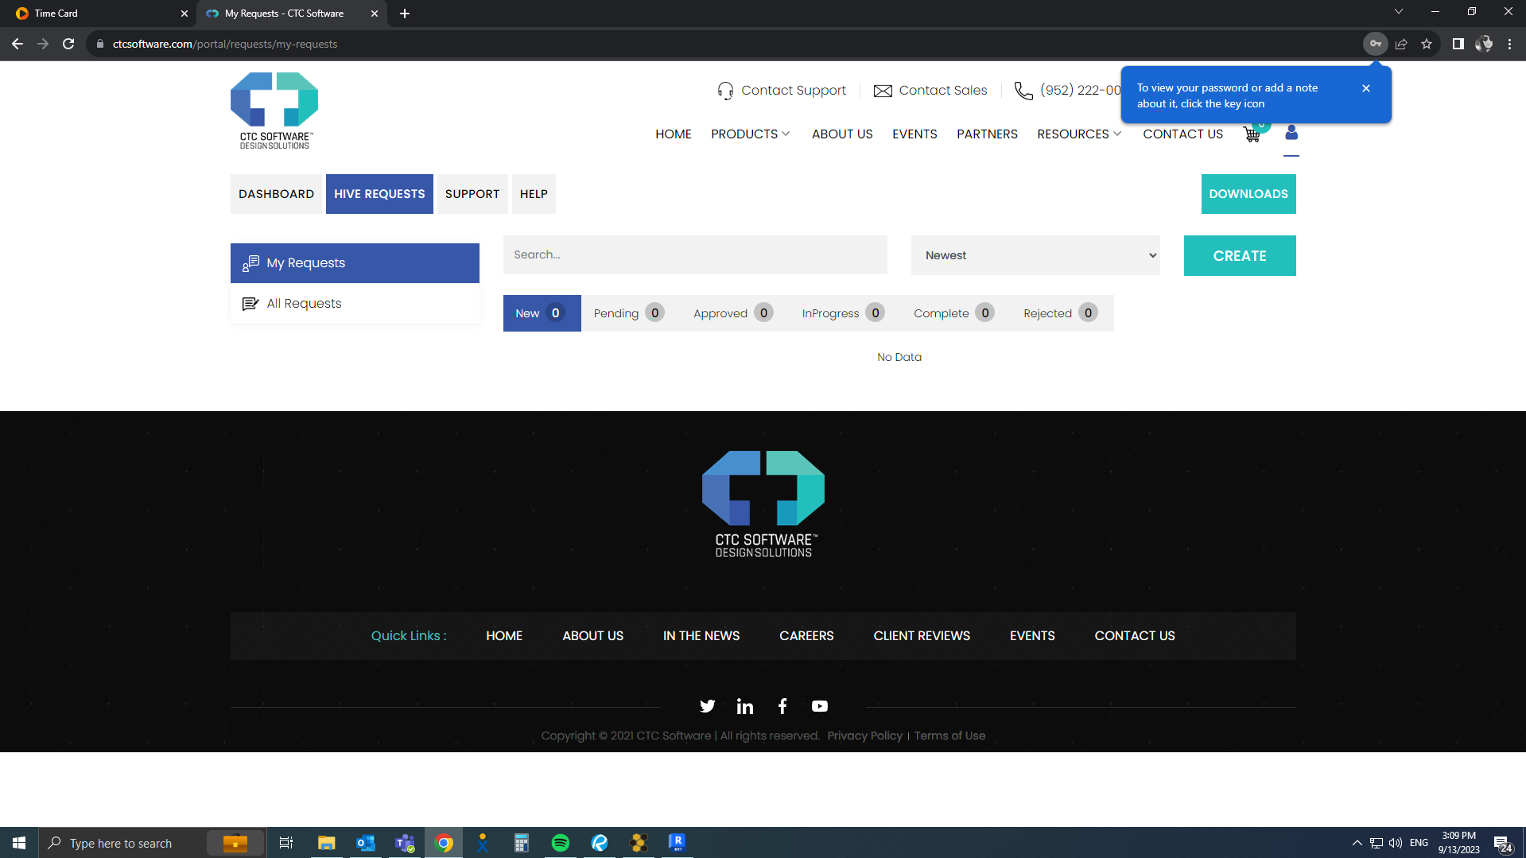
HIVE INTERFACE

Slide 13
HIVE INTERFACE
ADD REQUEST
Upload proposed file
Request content
Detail
Revit Family
Schedule
etc.

Slide 14
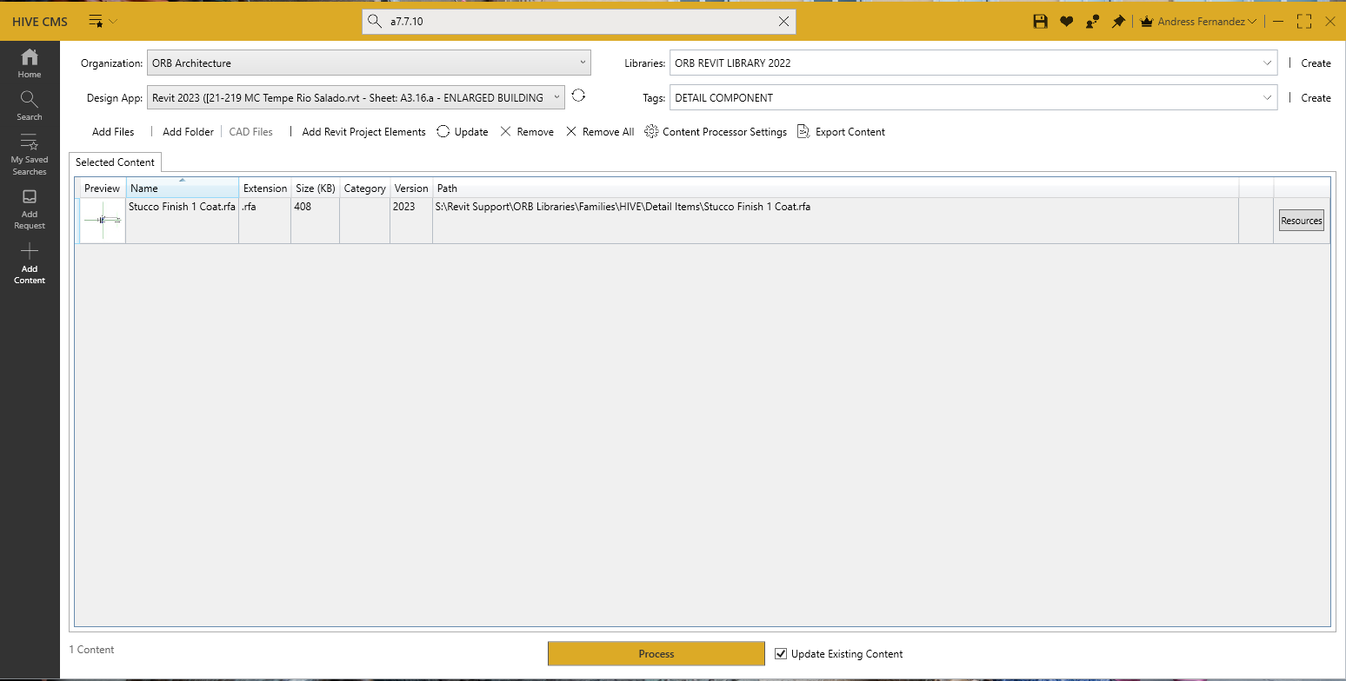
HIVE INTERFACE
ADD CONTENT
Limited to BIM management.
All embedded information is provided and reviewed prior to upload.
BIM Manager assigns TAGS for refined searching.

Slide 15
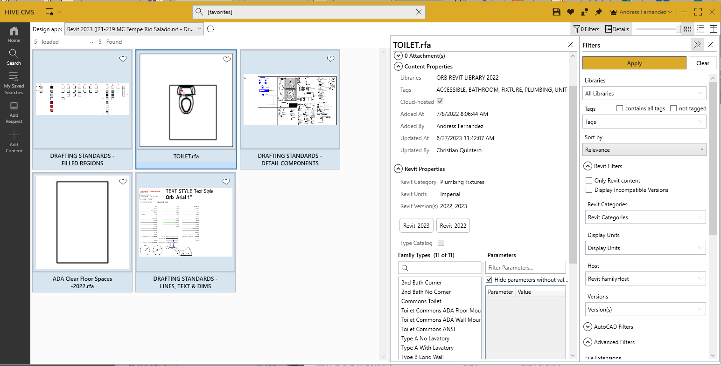
HIVE INTERFACE
FAVORITES
Single button access
No need to search
Readily available
Add or remove easily

Slide 16
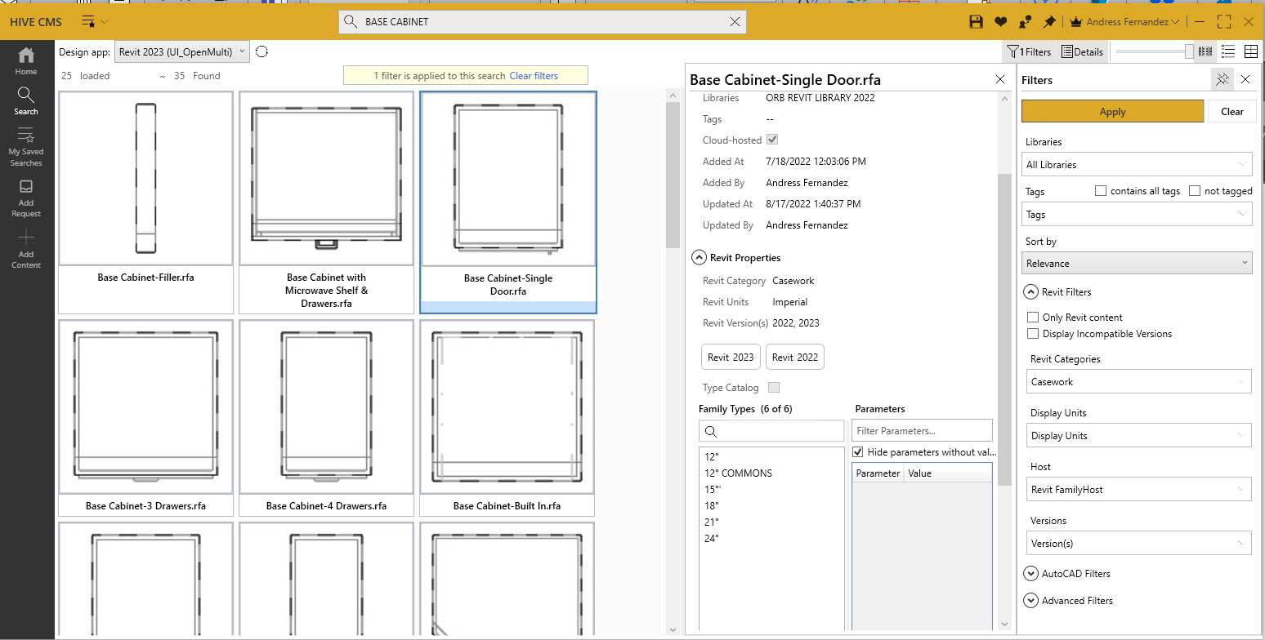
WORKING WITH HIVE

Slide 17
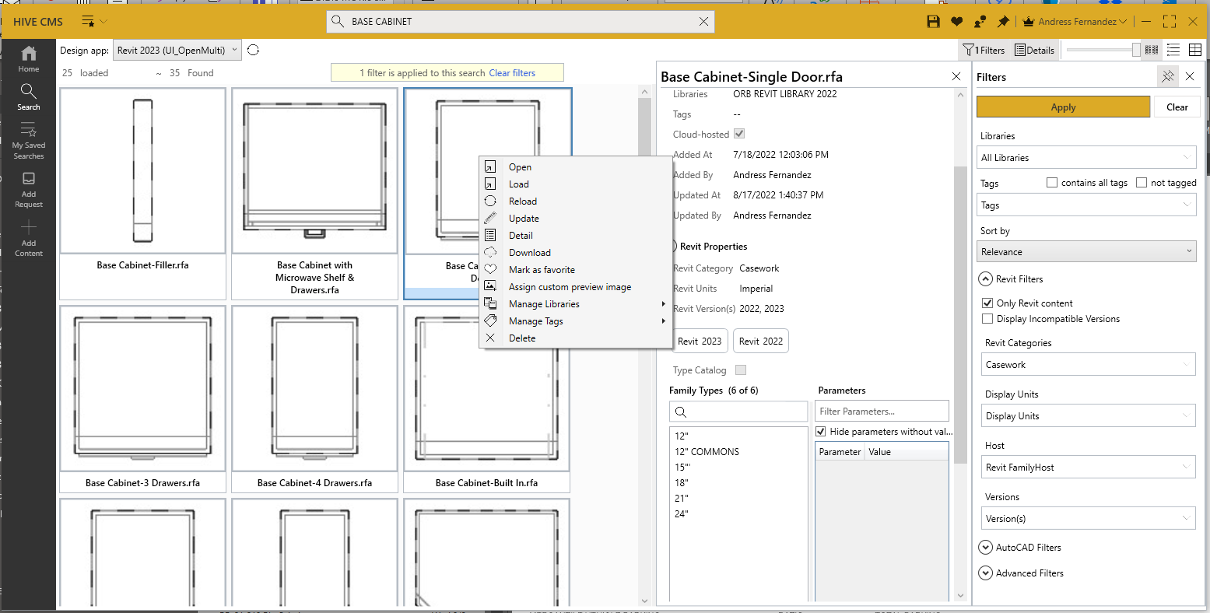
WORKING WITH HIVE
Use the “Reload” option whenever possible. The latest version of the family will load each time overriding the existing family.

Slide 18

REVIT MODEL HEALTH
We work with our models every day. It is imperative that these models remain clean and efficient for us to be able to get our work done in a timely manner and not waste time in front of the computer waiting for a view to regenerate constantly.
What to do:
Review the Model Health Checklist
Schedule Model health reviews with BIM Management at each phase
SD
DD
50% CD
100% CD
Show revised model after audit
Use content from Hive
Don’t bring content from other files. You will bring the good and the bad
Purge your model often
Delete views not used in sheets when possible (sections used when modeling)
Understand what the Family tree in the Project Browser is telling you

Slide 19
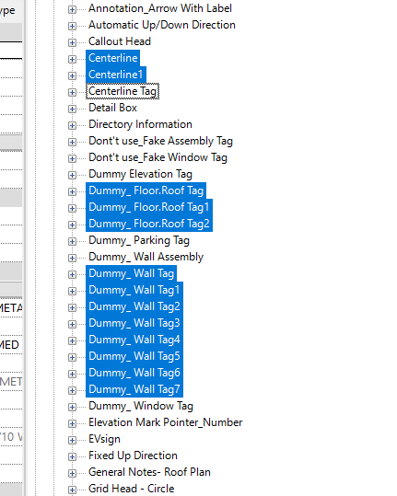
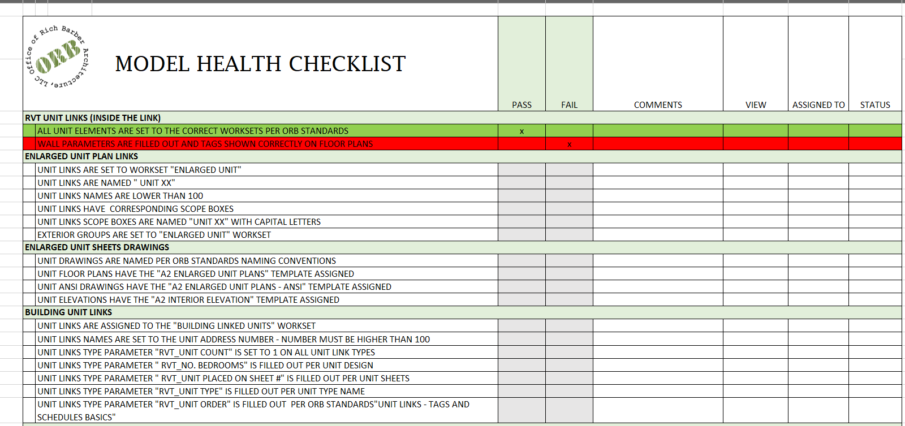
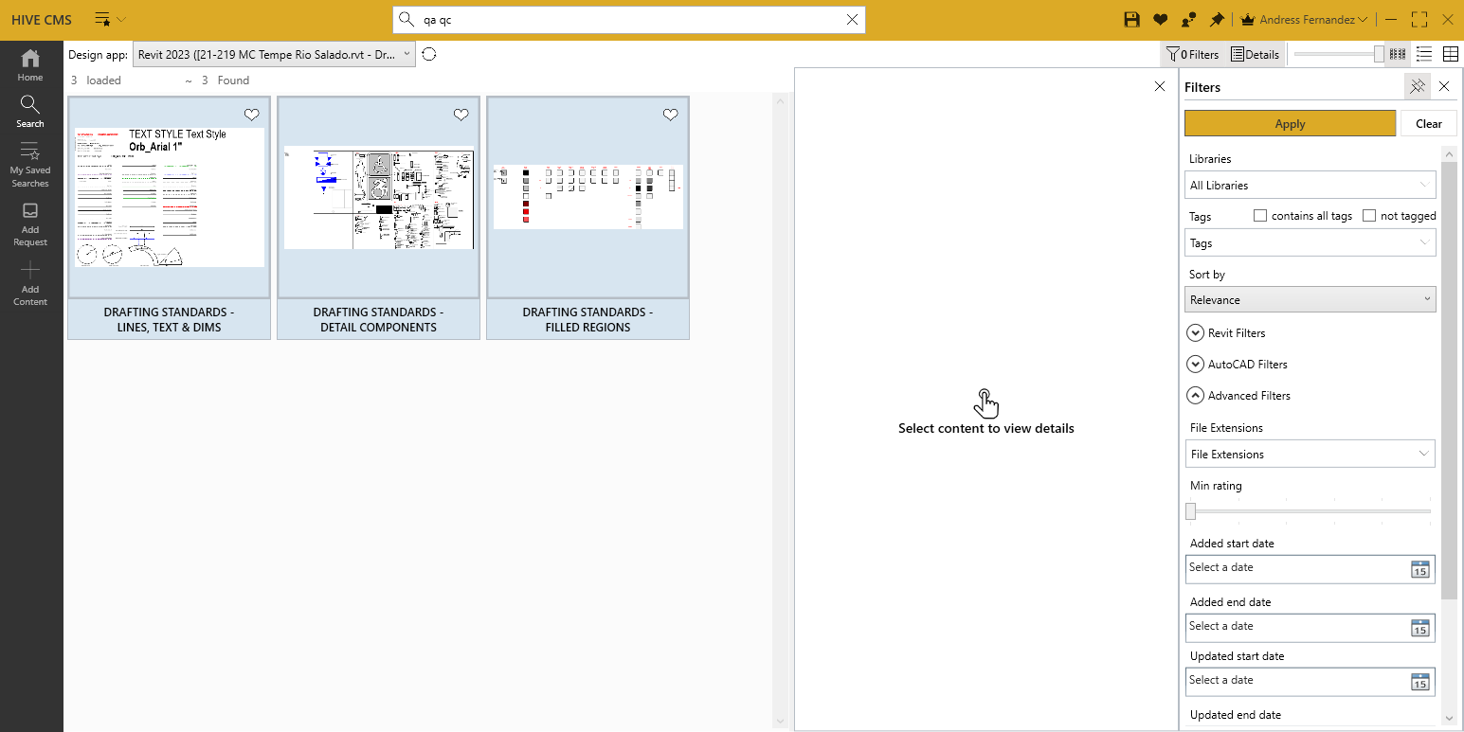
REVIT MODEL HEALTH
What to do:
Review the Model Health Checklist
Schedule Model health reviews with BIM Management at each phase
SD
DD
50% CD
100% CD
Show revised model after audit
Use content from Hive
Don’t bring content from other files. You will bring the good and the bad
Purge your model often
Delete views not used in sheets when possible (sections used when modeling)
Understand what the Family tree in the Project Browser is telling you
Clean up duplicate families often
Refer to the QA/QC drafting views

Slide 20




REVIT MODEL HEALTH
ORB PROCESS:
CONTENT FOUND
SEARCH HIVE
REQUEST
CONTENT
CONTENT NOT FOUND

